Slide 1



Noida Institute of Engineering and Technology, Greater Noida
Full-Stack Web Development using Laravel with Vue.JS
Course Code: ACSE0612
Unit: IV
Connecting Laravel with databases
Rupendra Kr. Kaushik
Assist. Professor
CSE
Course Details (B Tech 6th Sem)

Slide 2

Brief Introduction of Faculty
COURSE | BOARD/UNIVERSITY | YEAR OF PASSING
M.Tech | ITM, AKTU, Lucknow | 2022
B.Tech | PKITM, AKTU, Lucknow | 2014
Automatic Image Captioning Using
Ensemble of Deep Learning Techniques ” has been published in the AIR 2022
Organizing in Motilal Nehru National Institute of Technology Prayagraj.
A Comprehensive Review on Image Captioning Using Deep learning ” has been published in the AIR 2022 Organizing in Motilal Nehru National Institute of Technology Prayagraj.
AREA OF INTEREST
Deep Learning, Web Development and Nural Network

Slide 3
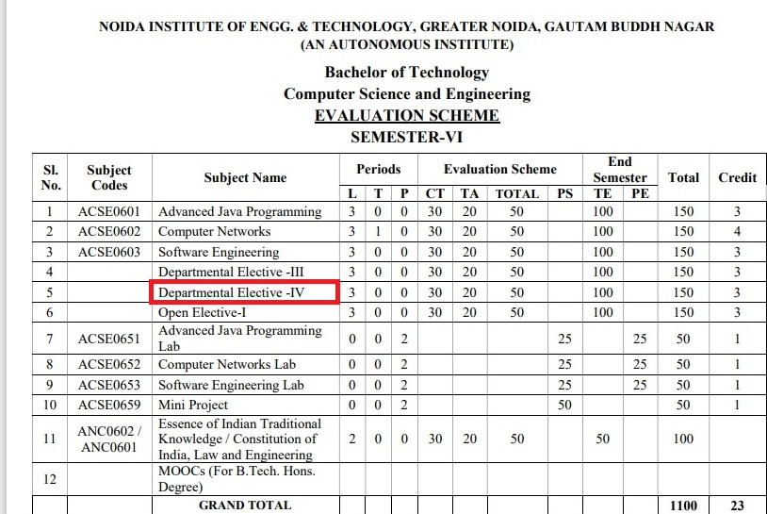
Evaluation Scheme

Slide 4
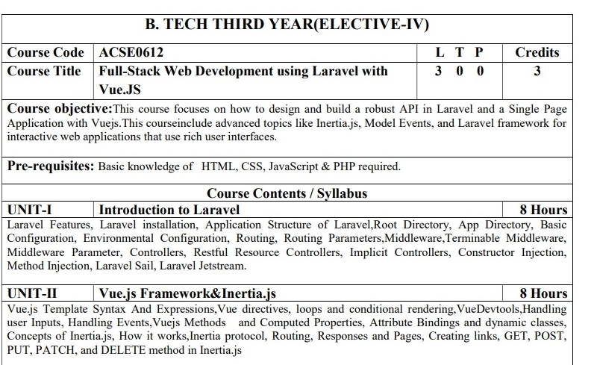
Syllabus

Slide 5
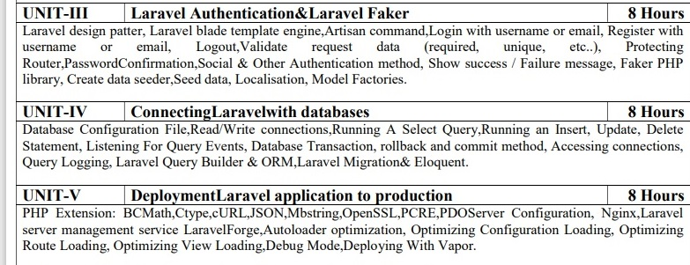
Syllabus (Cont…)

Slide 6
Branch Wise Application
Adaptability: It gives bother free migration, basic, and efficient structure.
Components: They help in creating custom elements that can be reused in HTML.
Transition: Various methodologies are given in Vue.js to apply a transition to HTML components when they are included or expelled from the DOM.
Detailed Documentation: It gives a simple learning curve through point-by-point documentation

Slide 7
Course Objective
1.Laravel Development Means Faster Time-To-Market. ...
2.Better Authentication and Authorization Option. ...
3.Stay Away from Technical Vulnerabilities with Laravel Framework. ...
4.MVC Architecture of Laravel Framework. ...
5.Automated and Unit Testing Feature. ...
6.Automated Task Execution and Scheduling

Slide 8
Course Outcomes (COs)
CO : 01. | Apply the knowledge of PHP that are vital in understanding Laravel application and analyze the concepts, principles and methods in current Server-side technology to implement Laravel application over the web.
CO : 02. | Explain, analyze and apply the role of Client-side scripting language like Vuejs in the workings of the web and web applications.
CO : 03. | Implementing and analyzing the concept of Larvel Faker and Authentication on Laravel.
CO : 04. | Understand the impact of web designing by database connectivity with different databases in the current market place where everyone use to prefer electronic medium for shoping, commerce, and even social life also.
CO : 05. | Analyzing and Creating a functional website using Laravel and Vuejs and Deploying and Optimizing Web Application using Forge / Vapor.

Slide 9
Program Outcomes (POs)
PO : 01. | Engineering Knowledge
PO : 02. | Problem Analysis
PO : 03. | Design/Development of solutions
PO : 04. | Conduct Investigations of complex problems
PO : 05. | Modern tool usage
PO : 06. | The engineer and society
PO : 07. | Environment and sustainability
PO : 08. | Ethics
PO : 09. | Individual and teamwork
PO : 10. | Communication
PO : 11. | Project management and finance
PO : 12. | Life-long learning

Slide 10
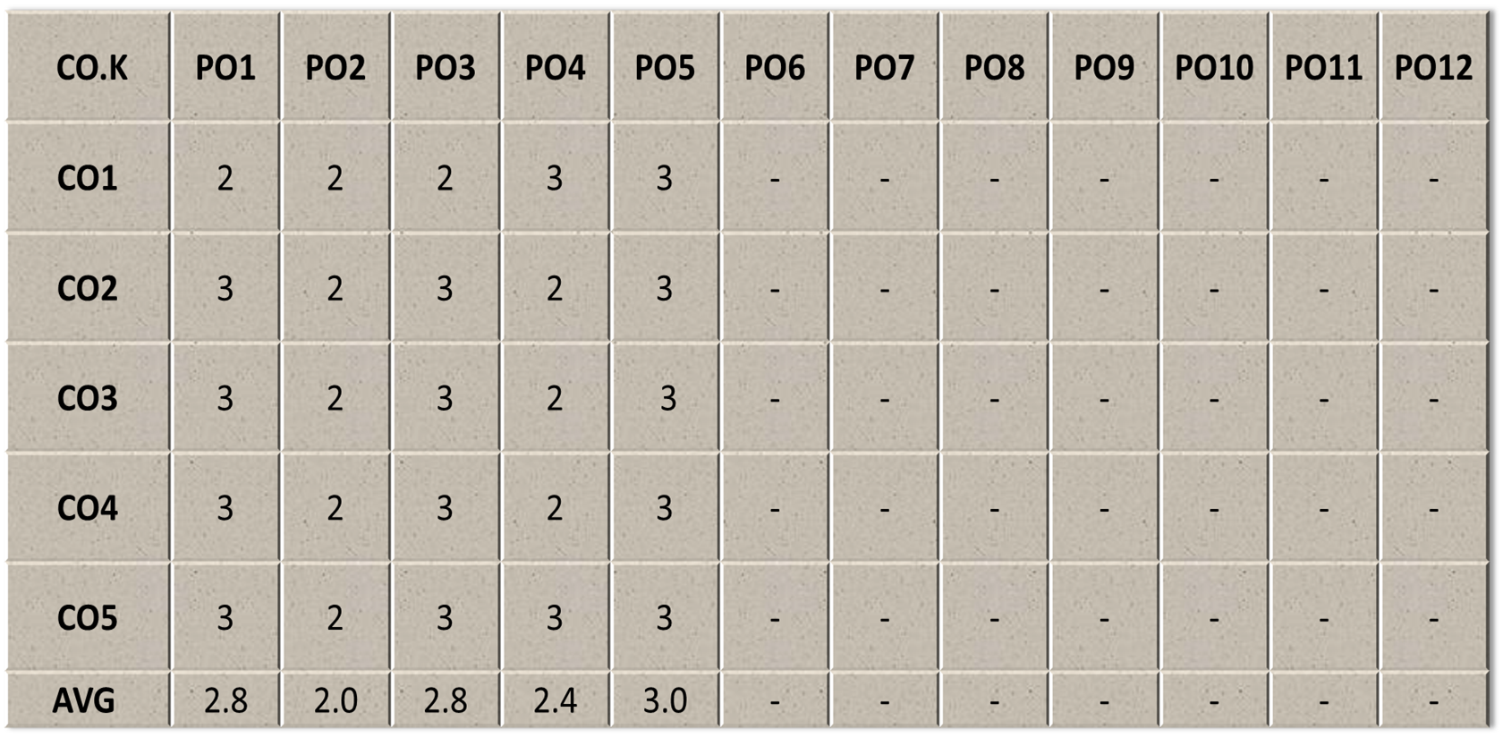
COs - POs Mapping

Slide 11
Program Specific Outcomes(PSOs)
Sr. No. | PSO Description
PSO1 | The ability to identify, analyze real world problems and design their ethical solutions using artificial intelligence, robotics, virtual/augmented reality, data analytics, block chain technology, and cloud computing.
PSO2 | The ability to design and develop the hardware sensor devices and related interfacing software systems for solving complex engineering problems.
PSO3 | The ability to understand inter-disciplinary computing techniques and to apply them in the design of advanced computing.
PSO4 | The ability to conduct investigation of complex problems with the help of technical, managerial, leadership qualities, and modern engineering tools provided by industry-sponsored laboratories.

Slide 12
COs - PSOs Mapping
CO.K | PSO1 | PSO2 | PSO3 | PSO4
CO1 | 3 | - | - | -
CO2 | 3 | 3 | - | -
CO3 | 3 | 3 | - | -
CO4 | 3 | 3 | - | -
CO5 | 3 | 3 | - | -

Slide 13
Program Educational Objectives (PEOs)
Sr. No. | PEOs Description
PEO 1 | To have an excellent scientific and engineering breadth so as to comprehend, analyze, design and provide sustainable solutions for real-life problems using state-of-the-art technologies.
PEO 2 | To have a successful career in industries, to pursue higher studies or to support entrepreneurial endeavors and to face the global challenges.
PEO3 | To have an effective communication skills, professional attitude, ethical values and a desire to learn specific knowledge in emerging trends, technologies for research, innovation and product development and contribution to society.
PEO4 | To have life-long learning for up-skilling and re-skilling for successful professional career as engineer, scientist, entrepreneur and bureaucrat for betterment of society.

Slide 14
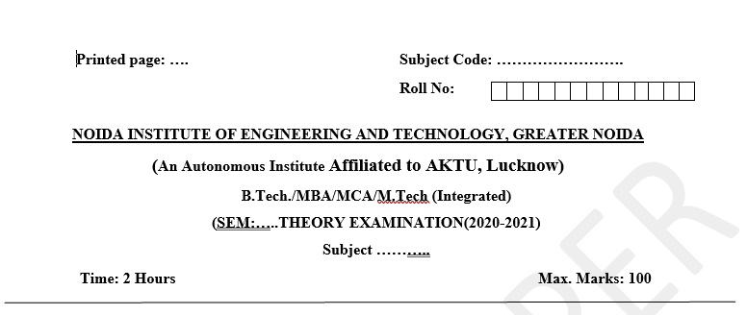
Pattern of Online External Exam Question Paper (100 marks)

Slide 15
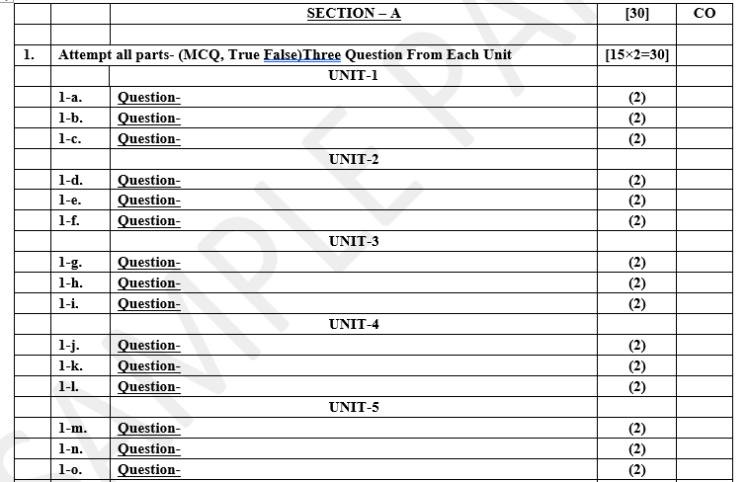
Pattern of Online External Exam Question Paper (100 marks)

Slide 16
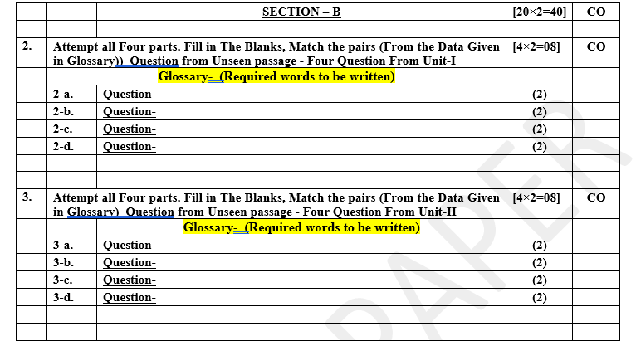
Pattern of Online External Exam Question Paper (100 marks)

Slide 17
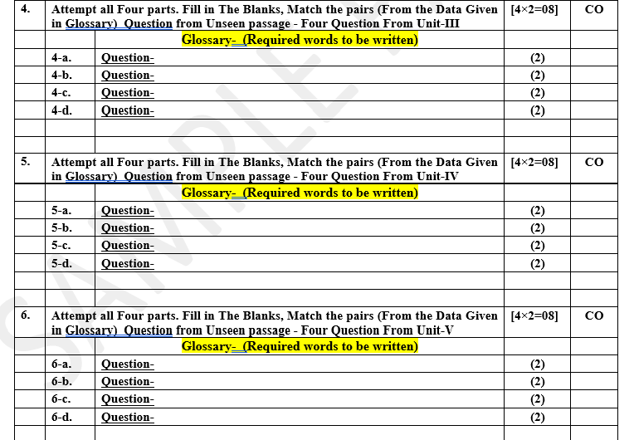
Pattern of Online External Exam Question Paper (100 marks)

Slide 18
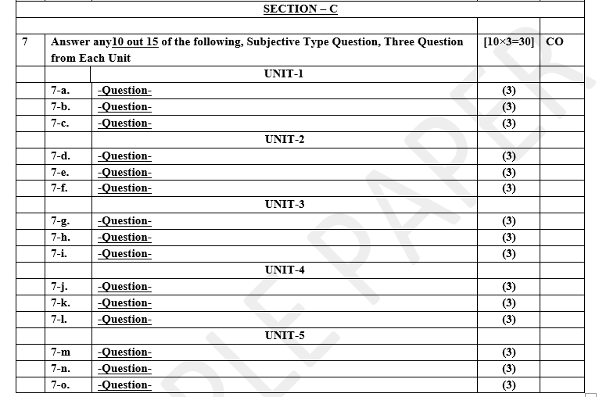
Pattern of Online External Exam Question Paper (100 marks)

Slide 19
Result Analysis
Branch | Result
CSE | 100%
IT | 98%

Slide 20
Prerequisite and Recap
Before begin progressing with this tutorial, We assume that we are familiar with website development using PHP and MySQL. Also we should be familiar knowledge of HTML, Core PHP, Java script And Advance PHP .
We have applied laravel version 5.1 in all the examples.

Slide 21
Brief Introduction about the Subject with videos
https://www.youtube.com/watch?v=DJ6PD_jBtU0&t=9s
https://www.youtube.com/watch?v=KIMolbzz8yM
https://www.youtube.com/watch?v=N_N-5RNowKw
https://www.youtube.com/watch?v=nNDBBkAR6BY
https://www.youtube.com/watch?v=5rPLtBHbOxo&list=PLs20WIPqzFC4_HynK6wTRIKEqKHiZYpa4&index=3

Slide 22
Unit content
Describing Database Configuration
Read/Write connections
Running A Select Query
Running an Insert, Update, Delete Statement
Listening For Query Events
Database Transaction
rollback and commit method
Accessing connections
Query Logging
Laravel Query Builder & ORM
Laravel Migration& Eloquent

Slide 23
Basic Database Usage
Configuration
Read / Write Connections
Running Queries
Database Transactions
Accessing Connections
Query Logging

Slide 24
Configuration
Laravel makes connecting with databases and running queries extremely simple. The database configuration file is app/config/database.php. In this file you may define all of your database connections, as well as specify which connection should be used by default. Examples for all of the supported database systems are provided in this file.
Currently Laravel supports four database systems: MySQL, Postgres, SQLite, and SQL Server.

Slide 25
Read/Write Connections
Sometimes you may wish to use one database connection for SELECT statements, and another for INSERT, UPDATE, and DELETE statements. Laravel makes this a breeze, and the proper connections will always be used whether you are using raw queries, the query builder, or the Eloquent ORM.
To see how read / write connections should be configured, let's look at this example

Slide 26
Read/Write Connections(Cont…)

Slide 27
Read/Write Connections(Cont…)
Note that two keys have been added to the configuration array: read and write. Both of these keys have array values containing a single key: host. The rest of the database options for the read and write connections will be merged from the main mysql array.
So, we only need to place items in the read and write arrays if we wish to override the values in the main array. So, in this case, 192.168.1.1 will be used as the "read" connection, while 192.168.1.2 will be used as the "write" connection.
The database credentials, prefix, character set, and all other options in the main mysql array will be shared across both connections.

Slide 28
Running Query
Once you have configured your database connection, you may run queries using the DB class.
Running A Select Query
$results = DB::select('select * from users where id = ?', array(1));
The select method will always return an array of results

Slide 29
An Insert Statement
the INSERT statement: it adds data to a table. The data is added as a new row in the table. The SQL INSERT statement inserts one or more rows of data into a table. You can also see INSERT written as INSERT INTO , but both behave the same. The inclusion of INTO is optional in most variants of SQL.
DB::insert('insert into users (id, name) values (?, ?)', array(1, 'Dayle'));

Slide 30
An Update Statement
UPDATE statement is a Structured Query Language (SQL) statement used to change or update values in a table. It is usually suffixed with a WHERE clause to restrict the change to a set of values that meet a specific set of criteria.
DB::update('update users set votes = 100 where name = ?', array('John'));

Slide 31
A Delete Statement
DB::delete('delete from users');
Note: The update and delete statements return the number of rows affected by the operation.

Slide 32
A General Statement
General statements are broad categories or groups of people or things. General statements may allude to the overall characteristics or elements of these categories or groups. They can be used as topic sentences, overall summarizations and to introduce a topic that will be expanded upon with a specific statement
DB::statement('drop table users');

Slide 33
Listening For Query Events
Laravel's events provide a simple observer pattern implementation, allowing you to subscribe and listen for various events that occur within your application. Event classes are typically stored in the app/Events directory, while their listeners are stored in app/Listeners. Don't worry if you don't see these directories in your application as they will be created for you as you generate events and listeners using Artisan console commands.
a single event can have multiple listeners that do not depend on each other. For example, you may wish to send a Slack notification to your user each time an order has shipped. Instead of coupling your order processing code to your Slack notification code, you can raise an App\Events\OrderShipped event which a listener can receive and use to dispatch a Slack notification.

Slide 34
Generating Events and Listeners
To quickly generate events and listeners, you may use the make:event and make:listener Artisan commands:
php artisan make:event PodcastProcessed
php artisan make:listener SendPodcastNotification --event=PodcastProcessed

Slide 35
Database Transaction
To run a set of operations within a database transaction, you may use the transaction method:
DB::transaction(function()
{
DB::table('users')->update(array('votes' => 1));
DB::table('posts')->delete();
});
Note: Any exception thrown within the transaction closure will cause the transaction to be rolled back automatically.
Sometimes you may need to begin a transaction yourself:
DB::beginTransaction();
You can rollback a transaction via the rollback method:
DB::rollback();
Lastly, you can commit a transaction via the commit method:
DB::commit();

Slide 36
Rollback and commit method
You can rollback the transaction via the rollBack method
DB::rollBack();
Lastly, you can commit a transaction via the commit method:
DB::commit();

Slide 37
Accessing Connections
When using multiple connections, you may access them via the DB::connection method:
$users = DB::connection('foo')->select(...);
You may also access the raw, underlying PDO instance:
$pdo = DB::connection()->getPdo();
Sometimes you may need to reconnect to a given database:
DB::reconnect('foo');
If you need to disconnect from the given database due to exceeding the underlying PDO instance's max_connections limit, use the disconnect method:
DB::disconnect('foo');

Slide 38
Query Logging
By default, Laravel keeps a log in memory of all queries that have been run for the current request. However, in some cases, such as when inserting a large number of rows, this can cause the application to use excess memory. To disable the log, you may use the disableQueryLog method:
DB::connection()->disableQueryLog();
To get an array of the executed queries, you may use the getQueryLog method:
$queries = DB::getQueryLog();

Slide 39
Laravel Query Builder & Eloquent ORM
An application always needs to interact with a database and Laravel makes this task hassle-free.
Few tools that make Laravel an awesome framework are the inclusion of
“The Query Builder and Eloquent ORM”.
Through this blog, I intend to share a few quick pointers on these concepts.

Slide 40
Query Builder
In Laravel, the database query builder provides an easy way to create and run database queries. It can use to perform all the database operations in your application, from basic DB Connection, CRUD, Aggregates, etc and it works on all database-supported systems like a champ.
The notable factor about query builder is that, since it uses the PHP Data Objects (PDO), we need not worry about SQL injection attacks (Make sure we don’t inadvertently remove this protection). We can avoid all those lines of code to sanitize the data before feeding it to the DB.
So, how do we create a simple select query to fetch all values from the user’s table?

Slide 41
Query Creation
$users = DB::table('users')->get();
DB::table is responsible to begin a fluent query against a database table. The table from which the value will select is mentioned inside the brackets within quotes and finally, the get() method gets the values. Similarly to fetch a single row we can modify the above code by adding a where clause
$user = DB::table('users')->where('name', 'shivam')->first();
Here, we are trying to fetch a row that has the value Shivam in its name column. The first() method will only return the first find. What if we need only the user id of Shivam? Instead of returning the entire result array, we can simply pluck out that specific column.

Slide 42
Query Creation(Cont…)
$user_id = DB::table('users')->where('name', 'shivam')->pluck('id');
For specifying more than one column we can use the select clause
$users = DB::table('users')->select('name', 'email')->get();
Moreover, now I believe you are getting the grip. Things get more interesting further down.
We often write queries against certain ‘where conditions’. So how do we fetch the list of users whose user_id is less than 10?
$users = DB::table('users')->where(id, '<', 10)->get();
Yes, we split up the operator and the operands as three parameters and feed it to the where conditions. Now we have a situation, we need to fetch all those users whose user_id falls between 10 and 20.
$users = DB::table('users')->whereBetween('id', array(10, 20))->get()

Slide 43
Query Creation(Cont…)
Laravel development services has the whereBetween(), whereNotBetween(), wherein() and whereNotIn() methods to which we can pass values as an array.
Why are we passing values as an array and not as comma-separated parameters?
Thus, at the start of this blog, I did mention SQL injection attacks. Let’s say that the values 10 and 20 are taken as user inputs.
As programmers, we cannot trust what the user types into the input field. He can be a valid user who enters proper values or someone trying to enter false values and crash your DB.
$users = DB::table('users')->whereBetween('id', array($from, $to))->get()

Slide 44
Eloquent in Laravel
Eloquent is an object that is representative of your database and tables, in other words, it acts as a controller between the user and DBMS
For eg,
DB raw query,
select * from post LIMIT 1
Eloquent equivalent,
$post = Post::first();
$post->column_name;

Slide 45
Eloquent in Laravel (Cont…)
The ORM included in Laravel is called Eloquent and it enables us to work with the database objects and relationships using an expressive syntax.
It is similar to working with objects in PHP. In Laravel development services, each database table has a corresponding “Model”.
Therefore, Eloquent ORM provides Active Record implementation which means that each model we create in our MVC structure corresponds to a table in our database.
Creating an Eloquent model is similar to creating a class. All the model files should be inside the app/models folder.
class Group extends Eloquent { }

Slide 46
Eloquent in Laravel (Cont…)
By default, Eloquent models will have auto-incrementing keys
$new_group = new Group;
$new_group->name = 'NewGroup';
$new_group->description = 'Awesome Group';
$new_group->save();
<read:< pre="">
<strong>// To get all groups</strong>
Group::all();
// To find a group by passing the group id etc.
Group::find($id);

Slide 47
Faculty Video Links, Youtube & NPTEL Video Links and Online Courses Details
https://youtu.be/UN3de_GEJiI
https://youtu.be/qCMgxDfRKCo
https://youtu.be/XP1DntIzyyI
https://youtu.be/Zf6o7ag5WPI
https://youtu.be/XoULf9nFclk

Slide 48
Daily Quiz
1 View files in Laravel end in
• .blade.php
• .php
• .vue
• .blade
2 Following methods are used in database migrations classes?
• execute() and rollback()
• up() and down()
• run() and delete()
• save() and update()
3 For what do the .env is used?
• For setting environment variables
• For running cron jobs
• For tracking vendors
• None of These

Slide 49
Daily Quiz
4 Routing file located in Laravel ?
• app/Http/
• routes/
• urls/
• vendors
5 Interpolation of variable in laravel done using
• compact
• {{}}
• helpers
6 We need to set database connection in Laravel?
• config.php
• setting.php
• In seed files
• .ENV file

Slide 50
Weekly Assignment
Explain database configuration process
Discuss read/write connection in connecting laravel with database
Explain Insert, Update, Delete statement with Example
Define Listening For Query Events? Explain in brief.
Discuss database Transaction
Explain Accessing connections in laravel
Explain logging in Laravel
What are migrations in Laravel
Explain Eloquent in Laravel
Define route groups

Slide 51
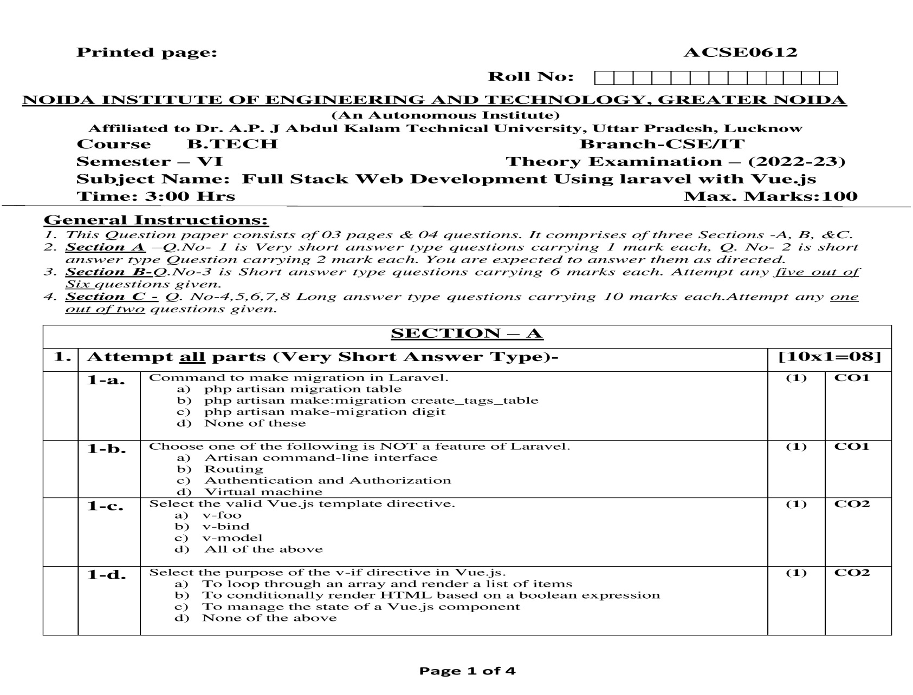
Old Question Paper

Slide 52
1. Explain Insert, Update, Delete statement with Example
2. Define Listening For Query Events? Explain in brief.
3.Discuss database Transaction
4. Explain Eloquent in Laravel

Slide 53
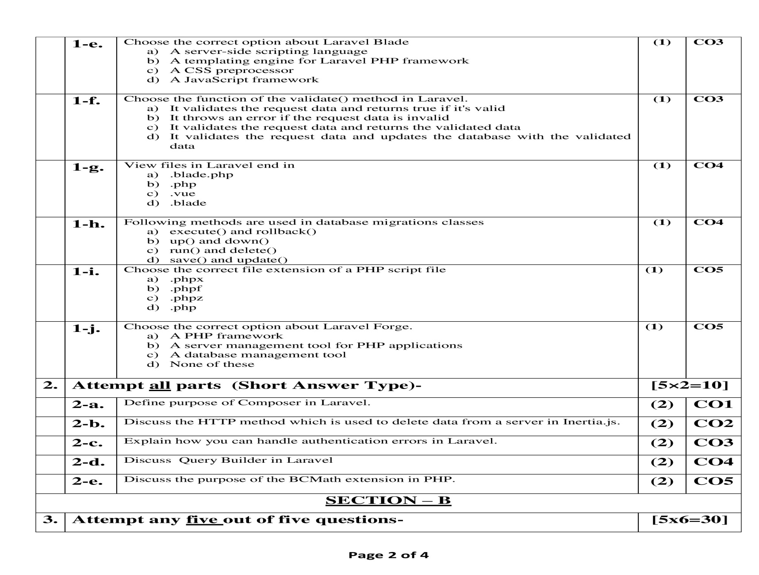
Old Question Paper

Slide 54
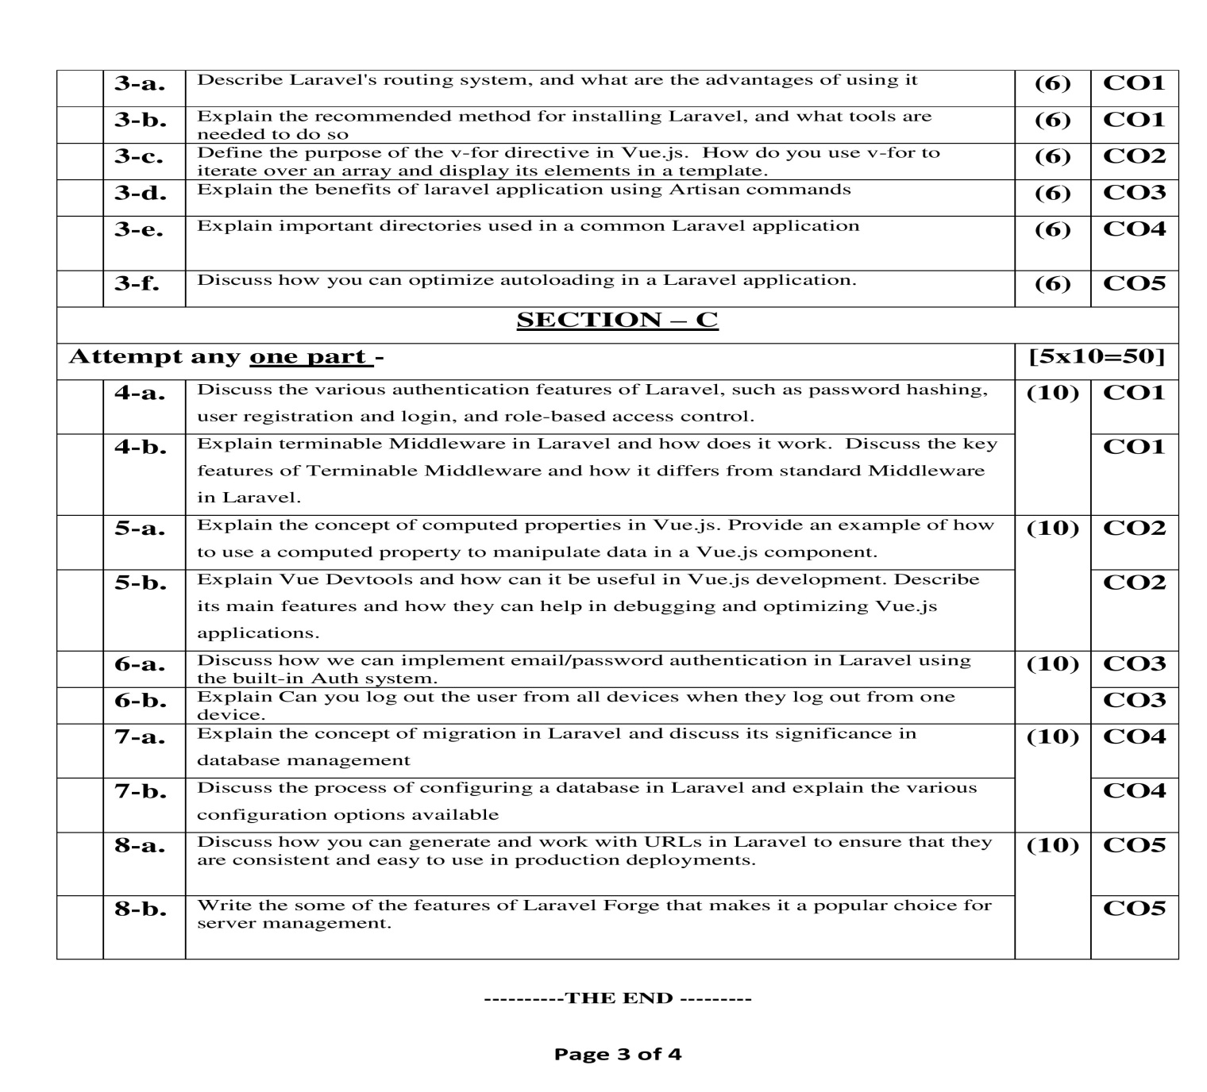
Old Question Paper

Slide 55
MCQ s
A. Laravel Created by
1.Margon Stan
2.Taylor Otwell
3.Samsy Twig
4.None of these
B.Command to get the route list in Laravel?
1.php artisan list
2.php artisan route:list
3. php artisan route
4.php artisan list:all
C.CLI Command to create controller in laravel?
1.php artisan make:controller Mycontroller
2.php artisan create:controller Mycontroller
3. php artisan controller Mycontroller
4. None of these

Slide 56
MCQ s
D. complie.php file is for
a. Executing package auto loading
b. Define additional class file
c. Executing all controllers
d. None
E. Command is used to start PHP’s built-in development server?
a. %>php start server
b. %>php start dev server
c. %>php artisan serve
d. %>php arisan server
F. To find log files in laravel used
a. Storage\logs
b. App\logs
c. Resources\Logs
d. Public\Logs

Slide 57
Expected Questions for University Exam
1. Explain the term Eloquent ORM
2.Discuss Query Builder in Laravel
3.Define is routing
4.Explain what do you understand by Reverse routing
5.Discuss step by step how do you generate migrations
6.Explain important directories used in a common Laravel application
7.Differentiate between insert() and insertGetId() in Laravel

Slide 58
References
Thank You

